Slide 1
TEST KIT
Alice X.

Slide 2
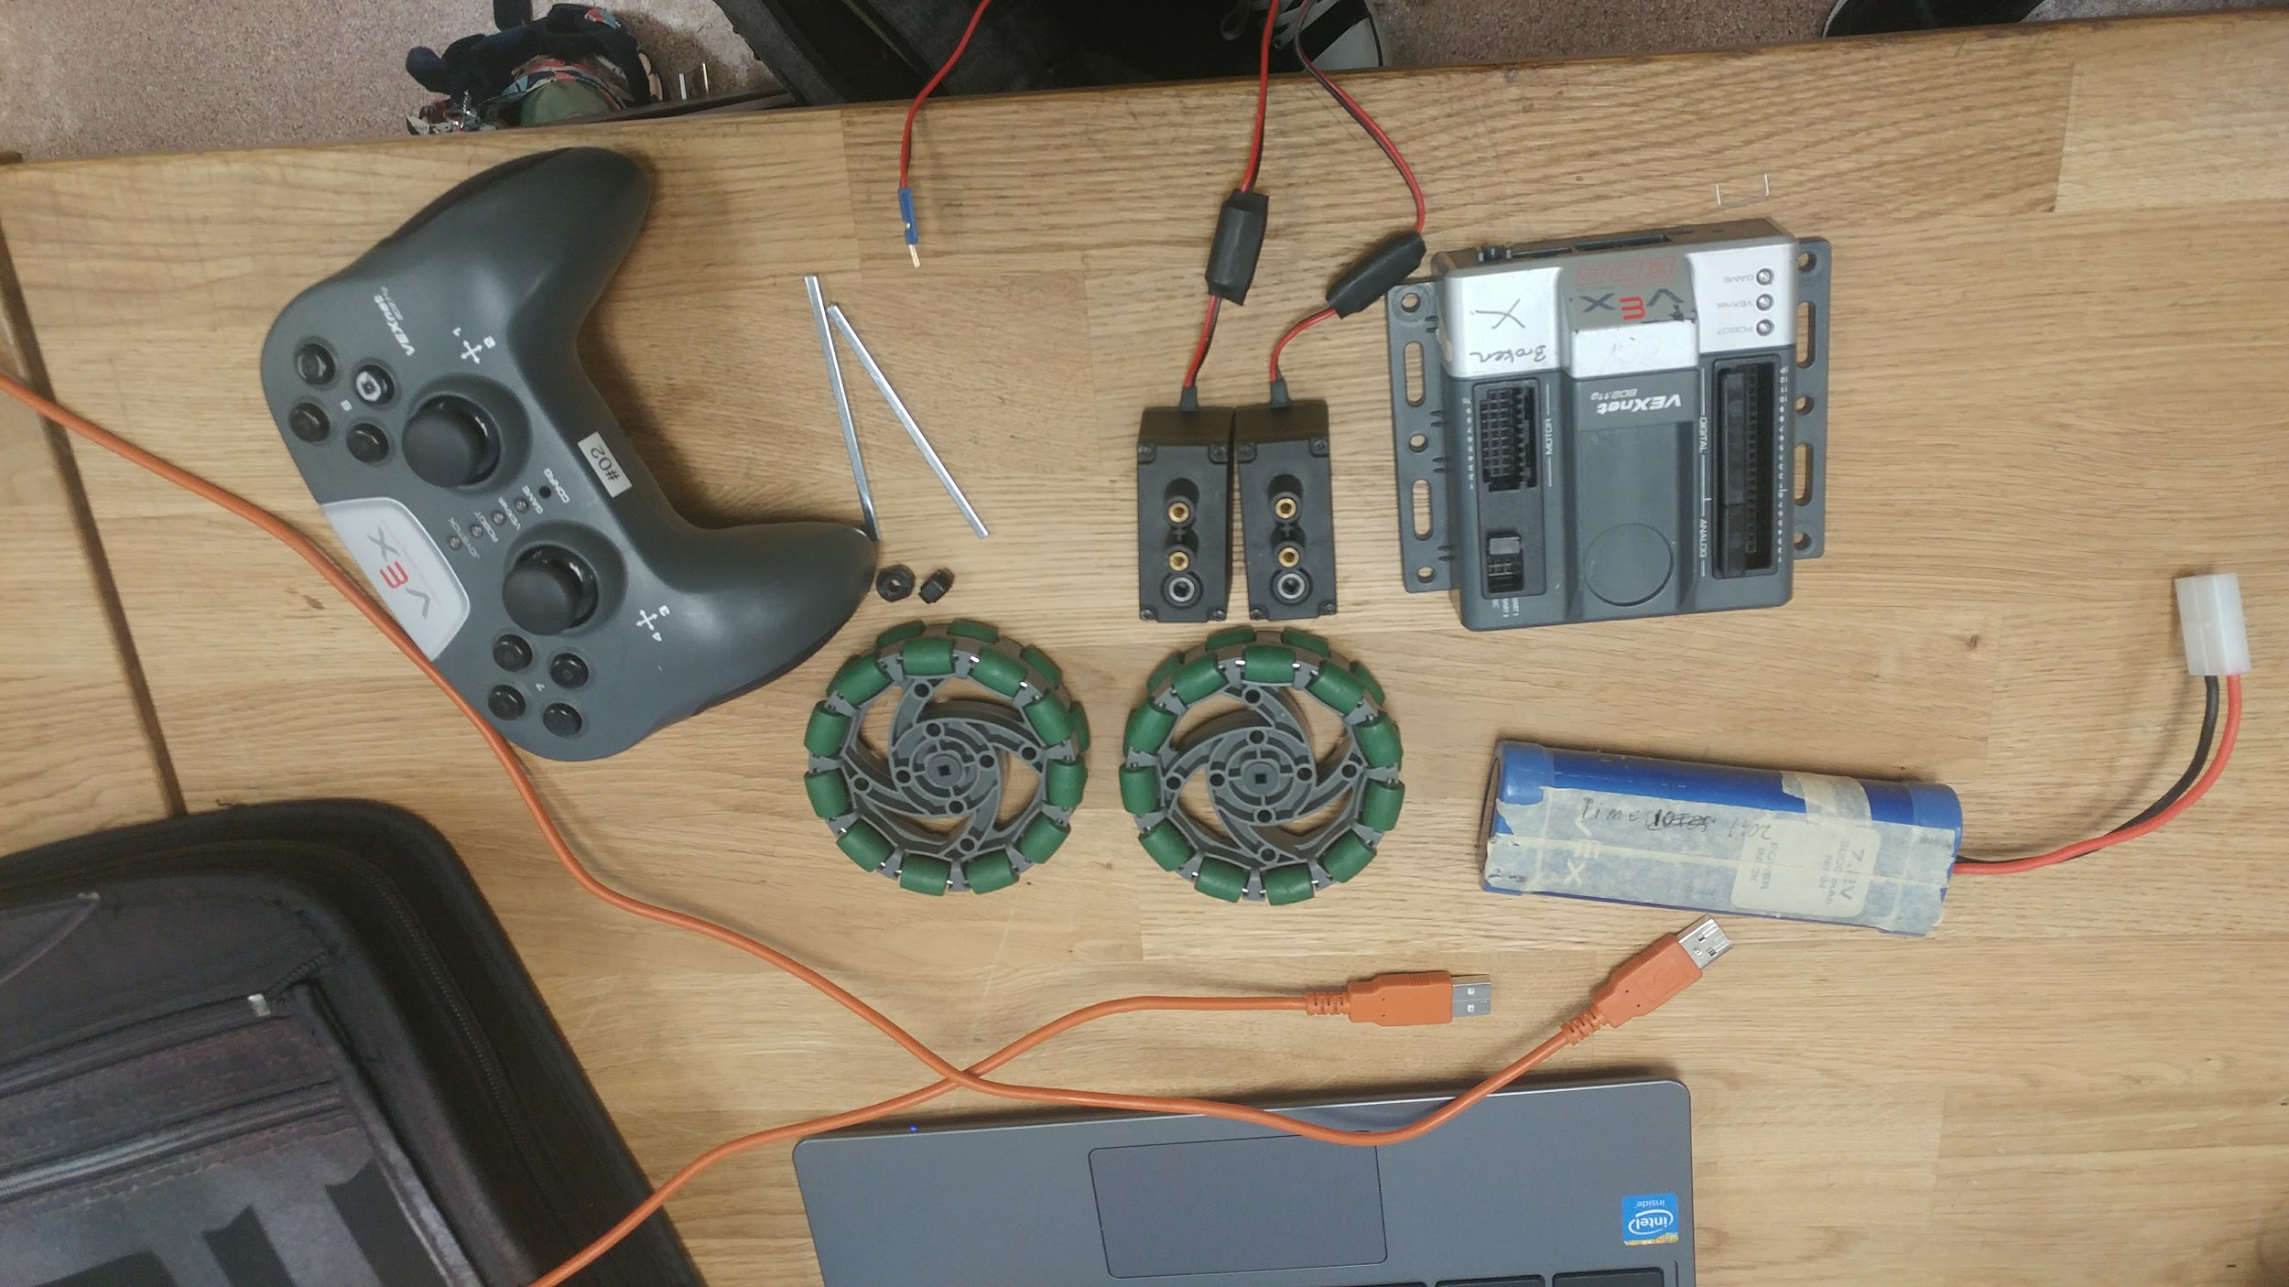
Here are all the materials you need:
2 motors
2 shafts (3’’)
2 rubber collars
2 omni wheels (or any wheels)
1 VEX cortex
1 battery
1 A-to-A cable
1 laptop for programming

Slide 3
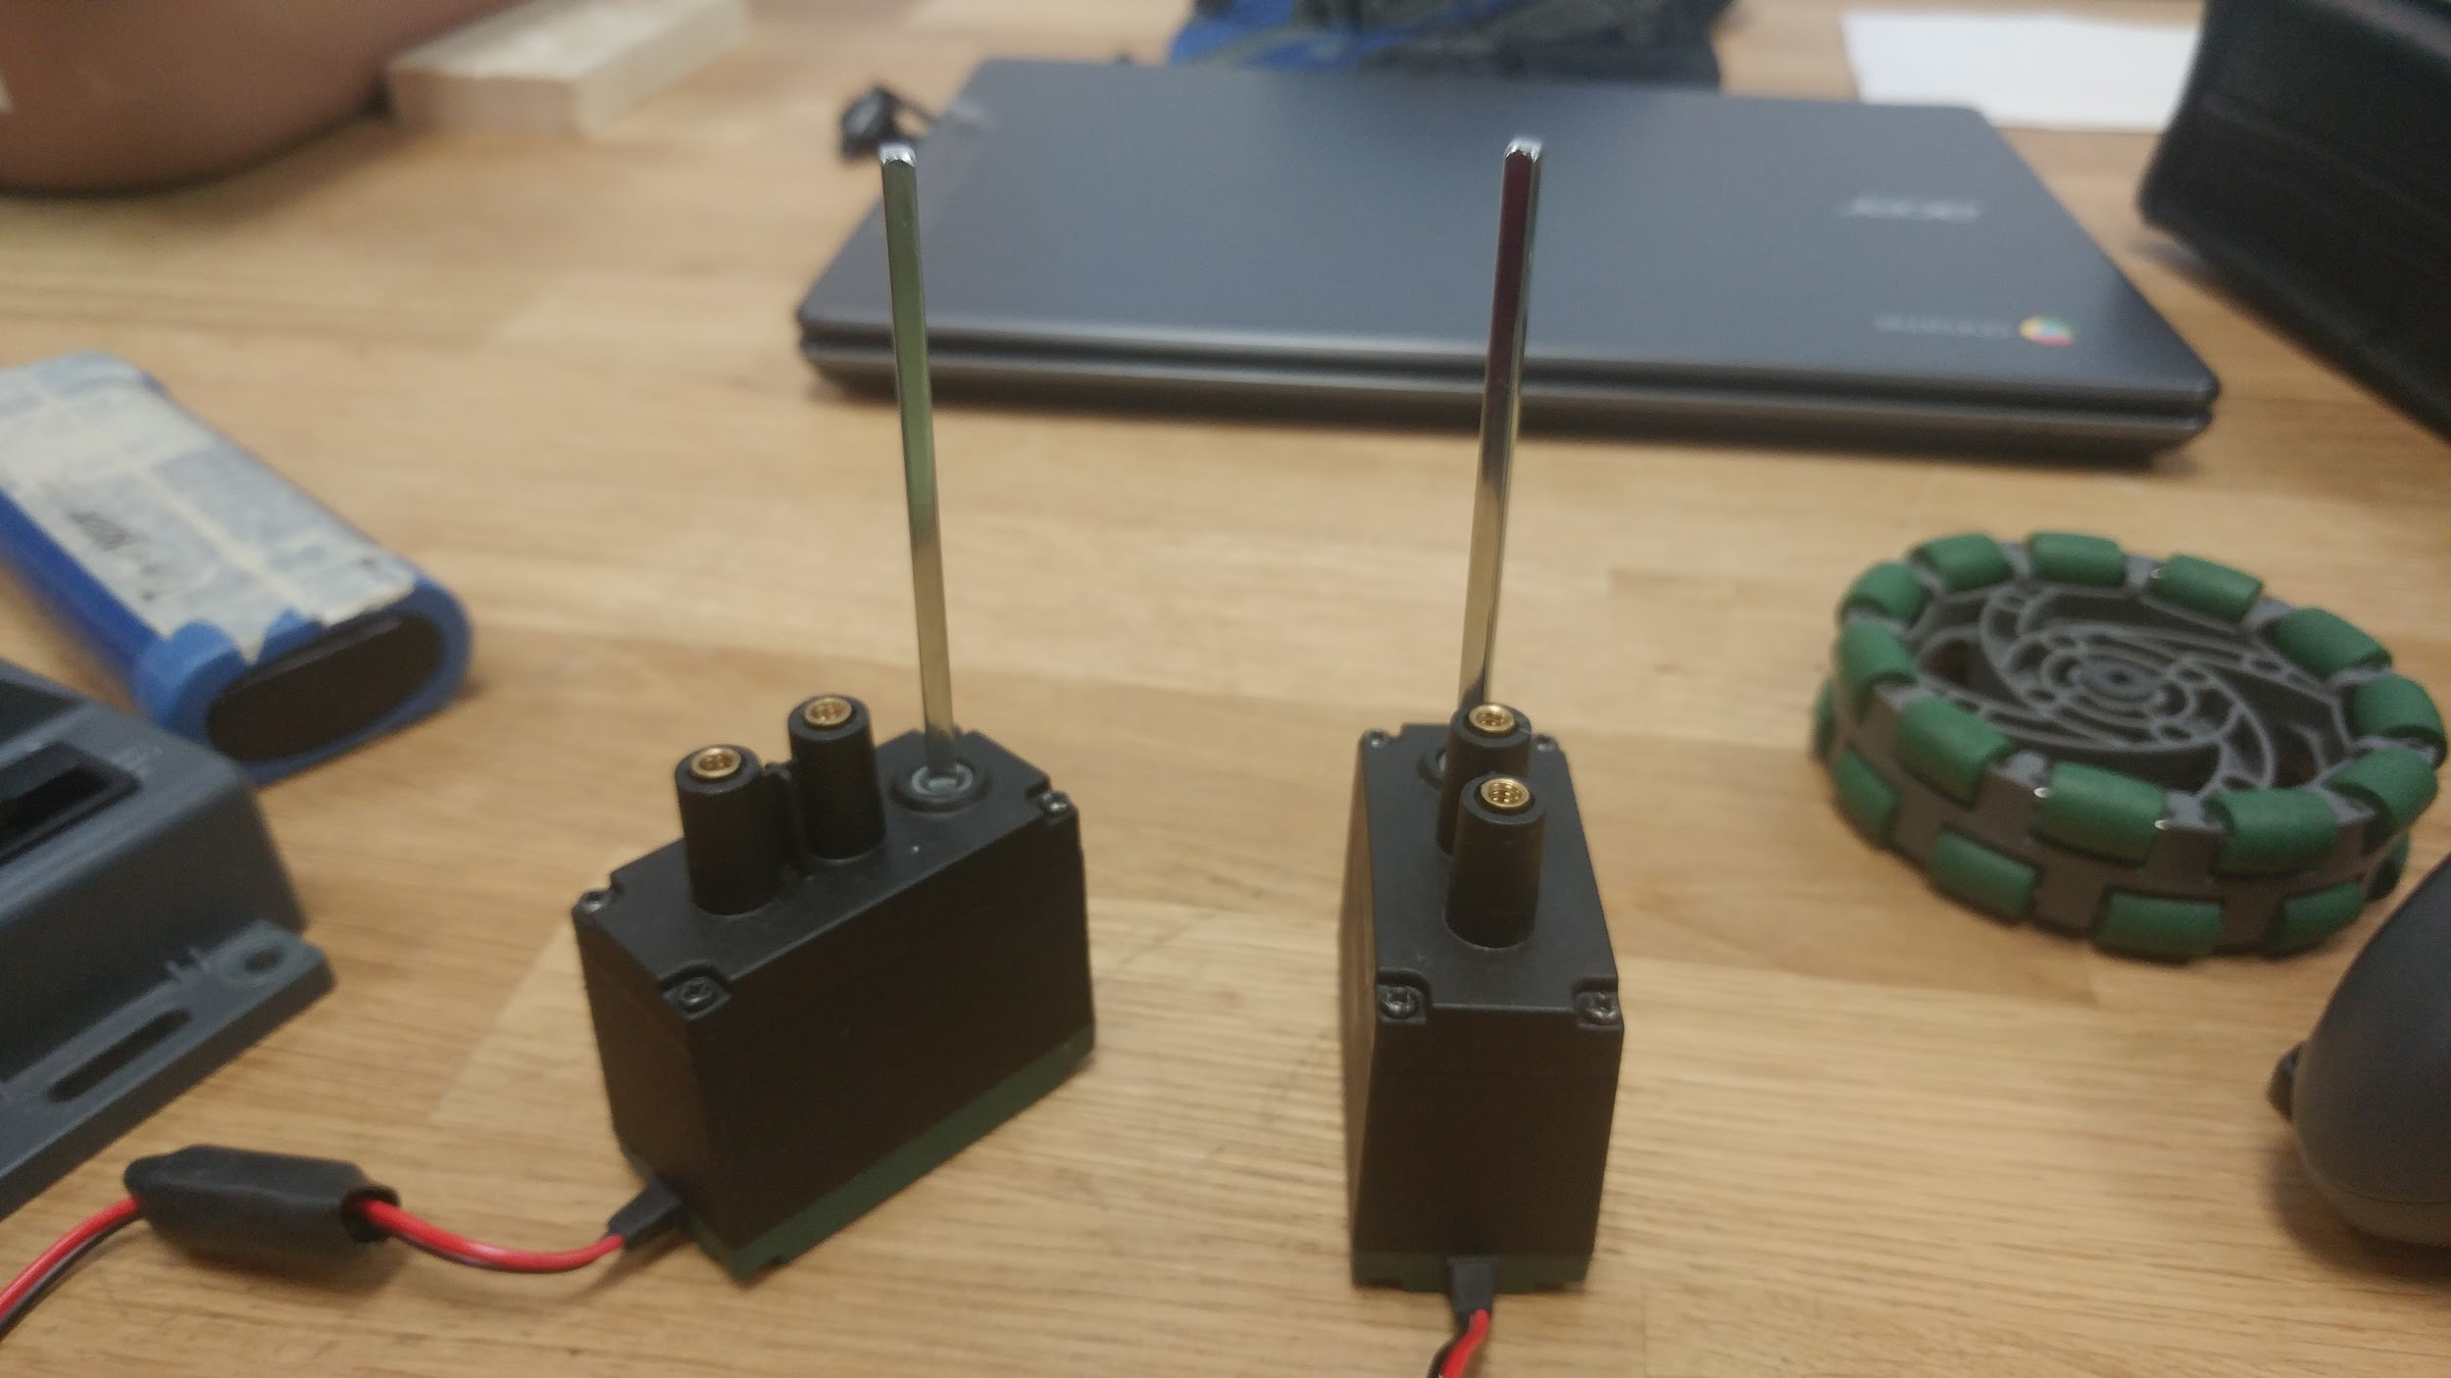
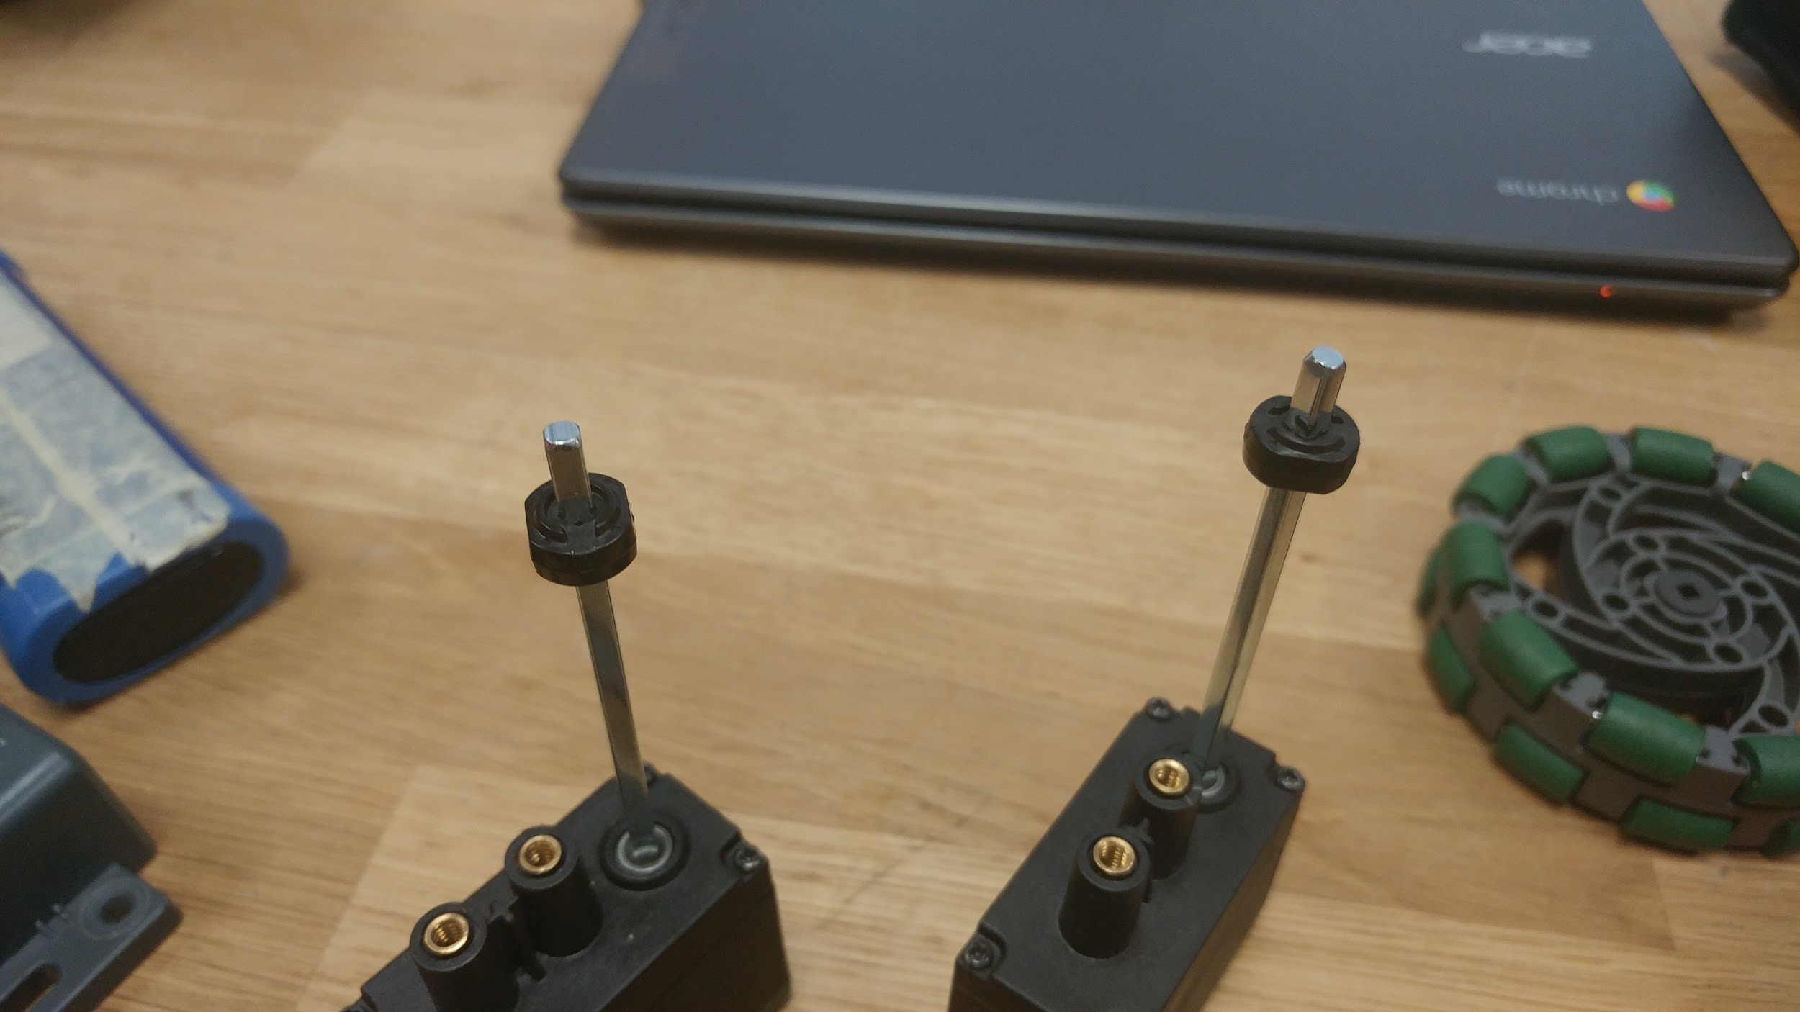
Step 1:
Put the shafts in the motors.
Step 2:
Slide the rubber collar on the shafts. The position of the collar can be adjusted later.

Slide 4
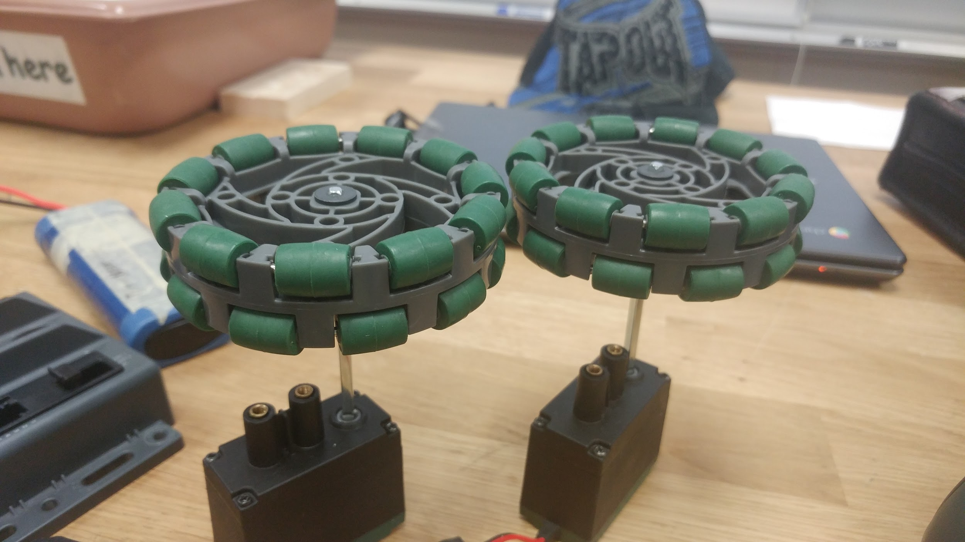
Step 3:
Place the wheels on the top of the shafts. Adjust the position of the collar so that the shafts fully go through the wheels.

Slide 5
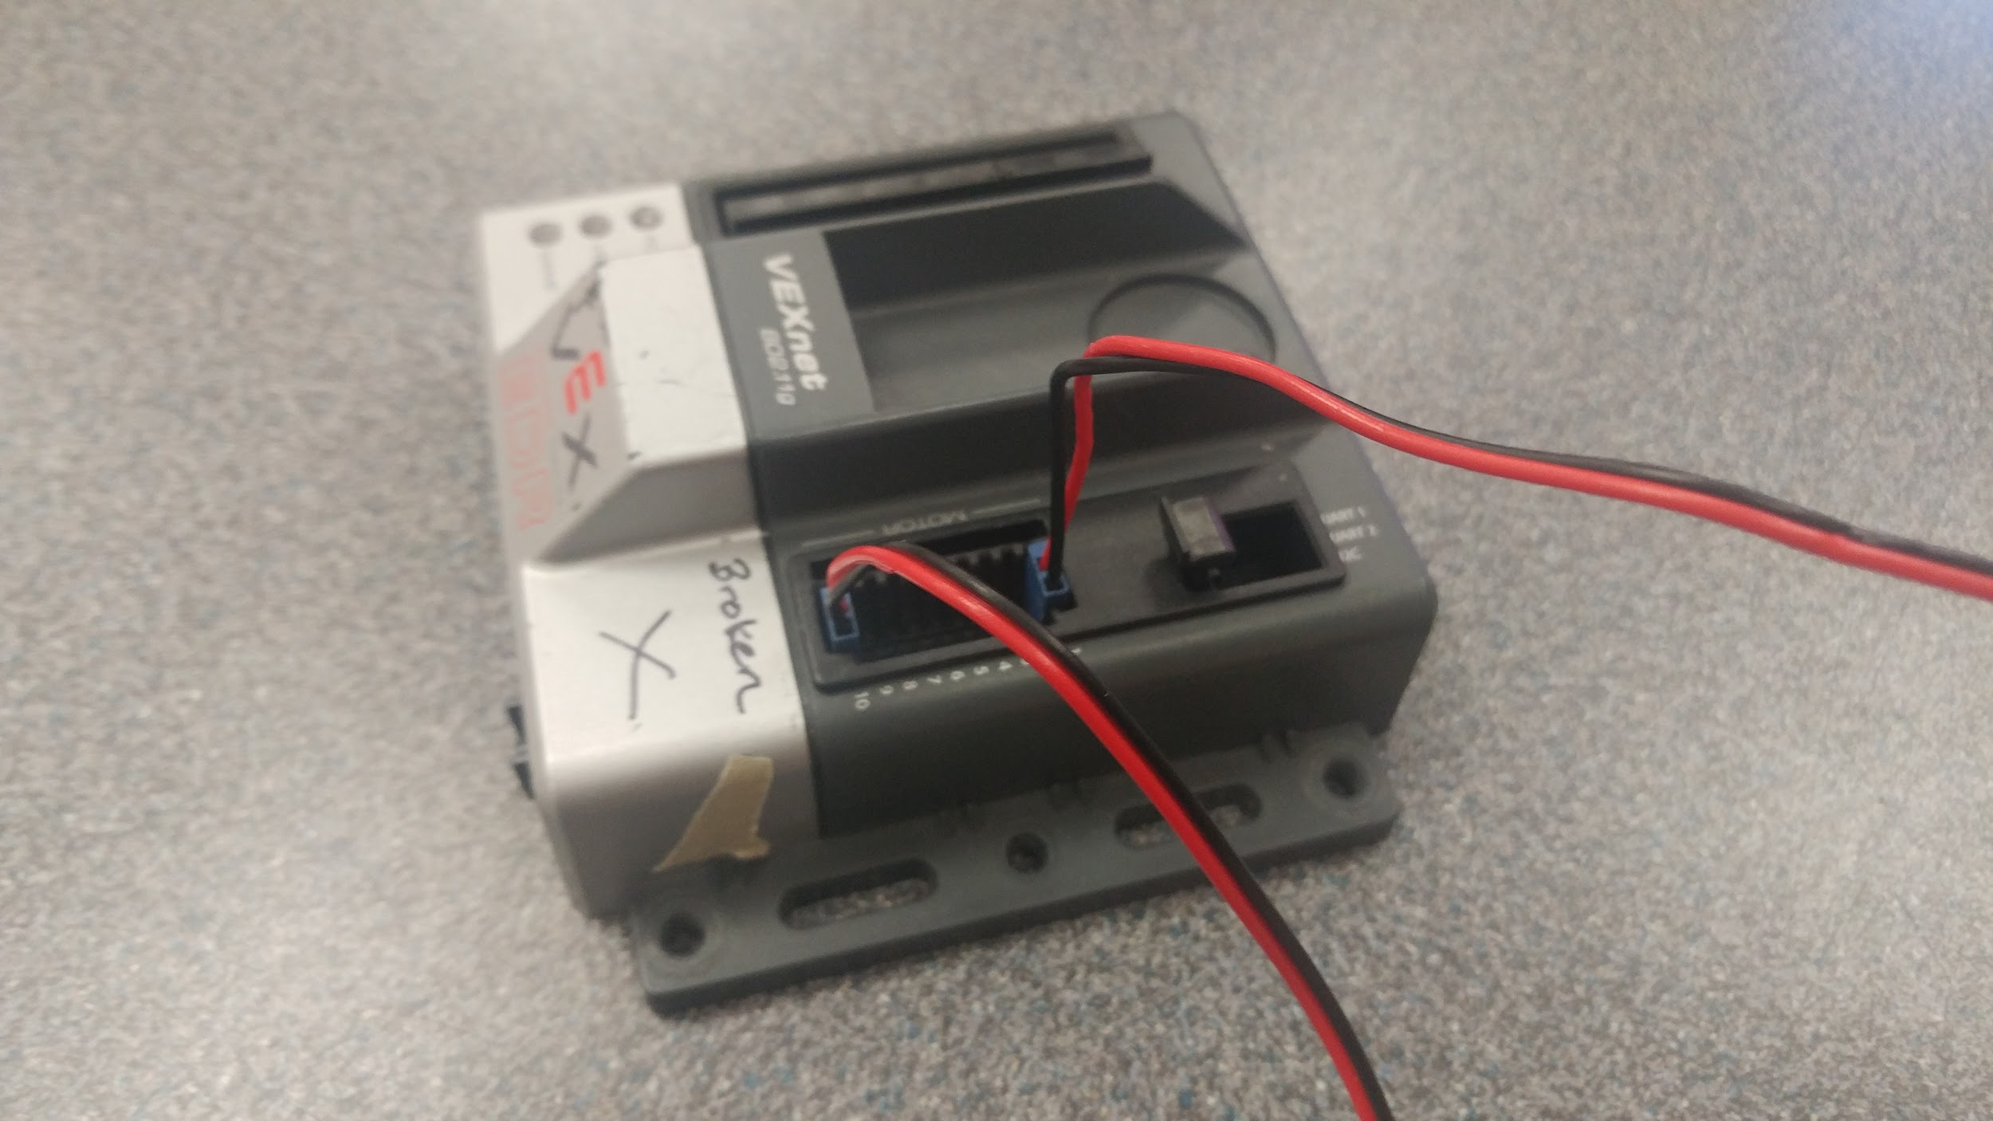
Step 4:
Plug the two pin motors in motor ports 1 & 10. Make sure the black wire is on the outside.

Slide 6
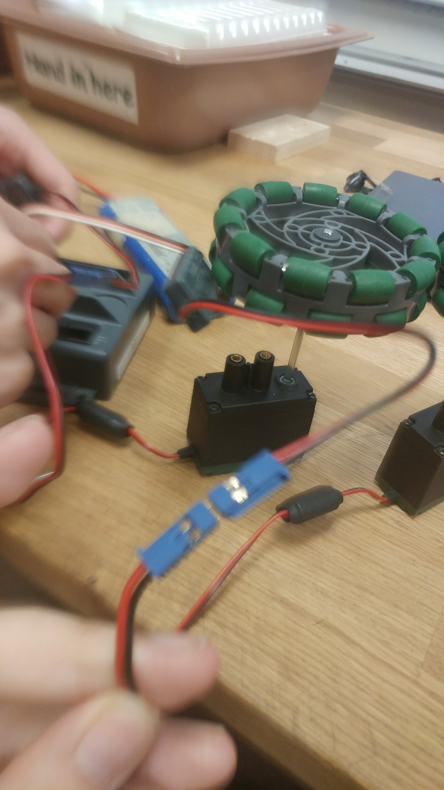
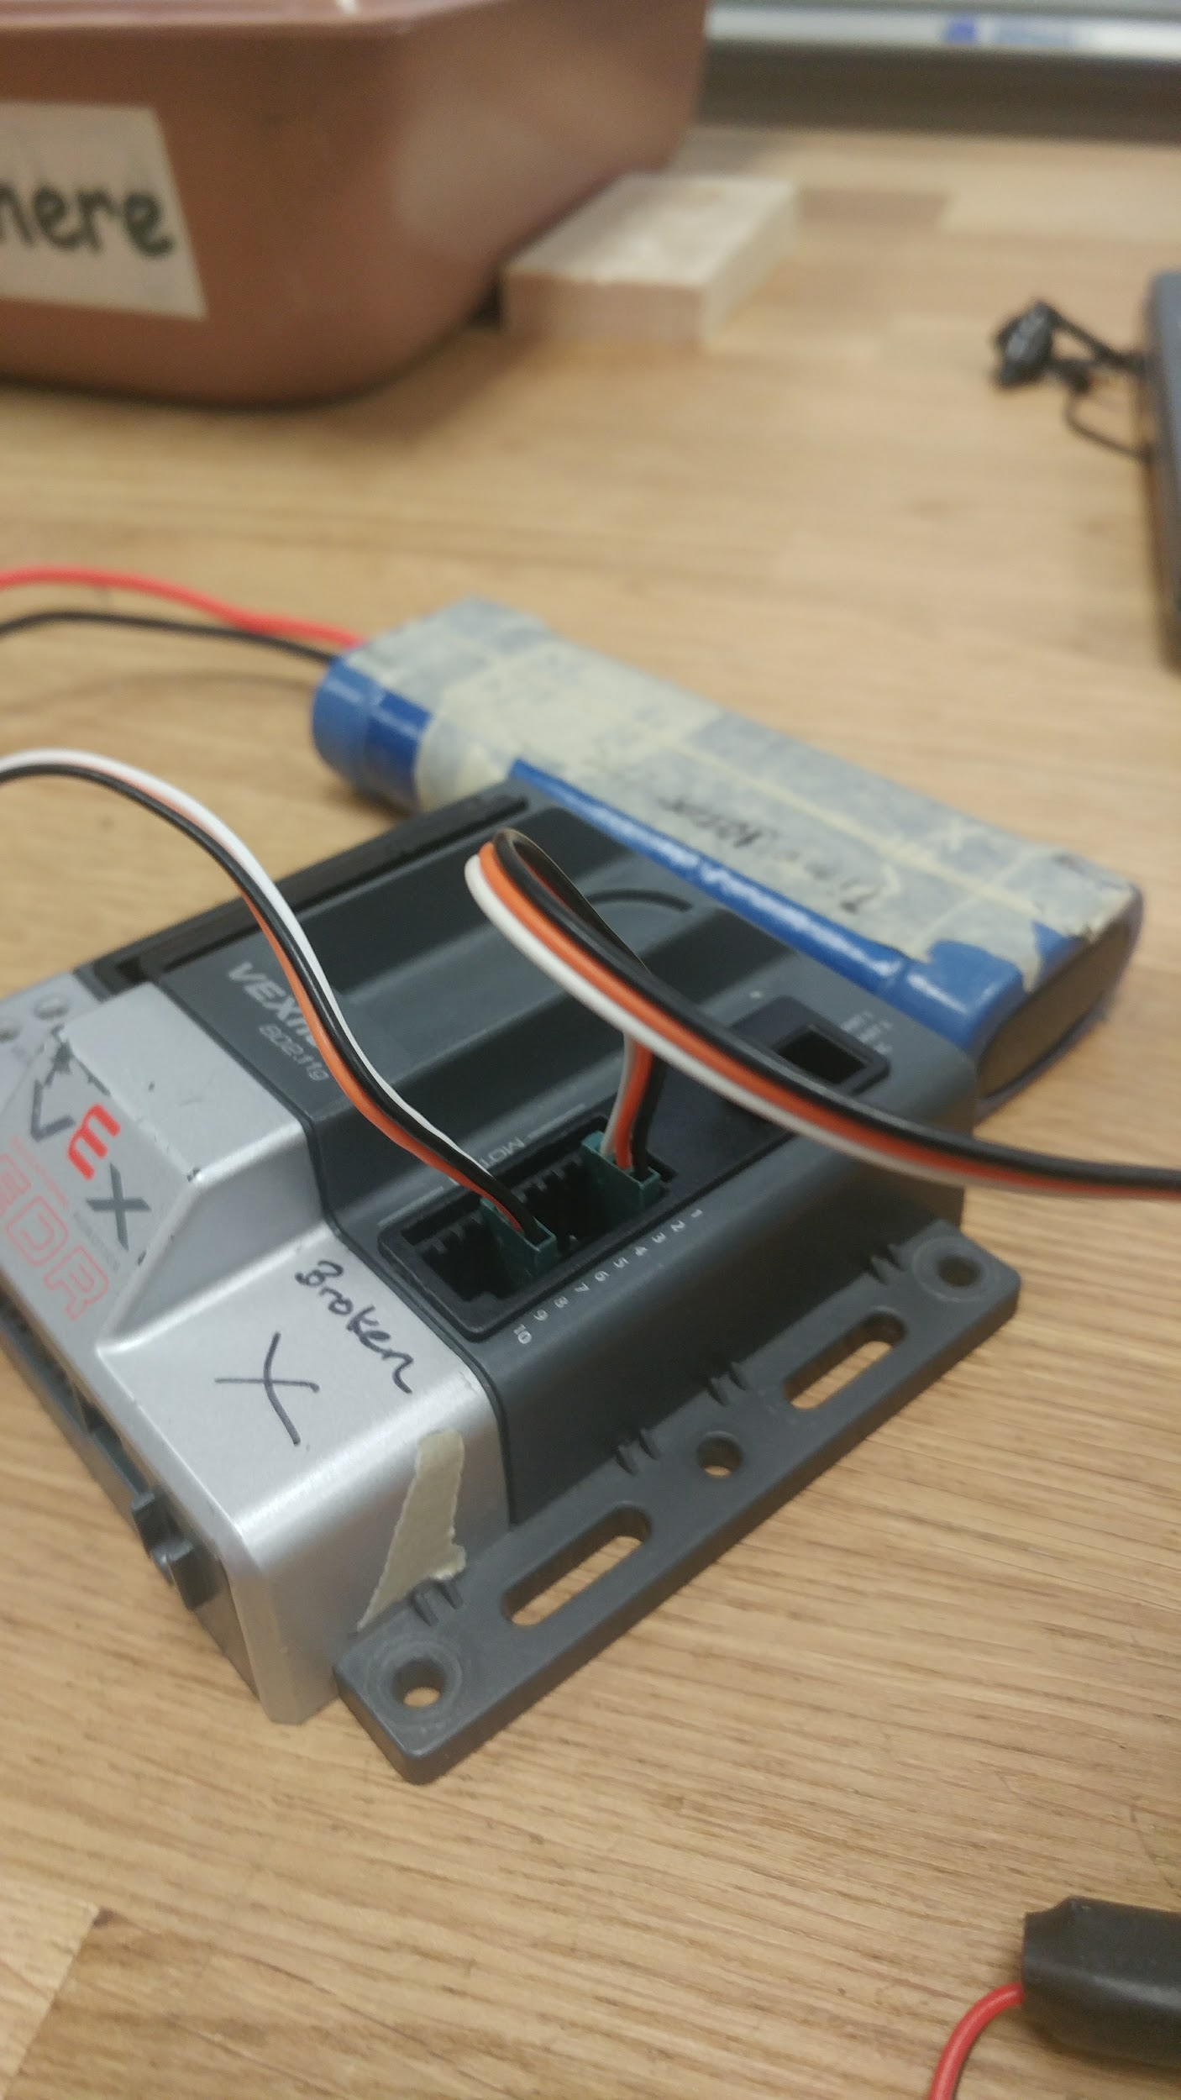
Step 4*:
If you want to plug the motors into ports 2 - 9, you will need a motor controller that converts 2 pin into 3 pin.
Make sure the motor controller is plugged in so that its black wire goes into the black wire of the motor.
Then plug the motor controller into motor ports 2 - 9 of the cortex. Again, the black wire should face outward.

Slide 7
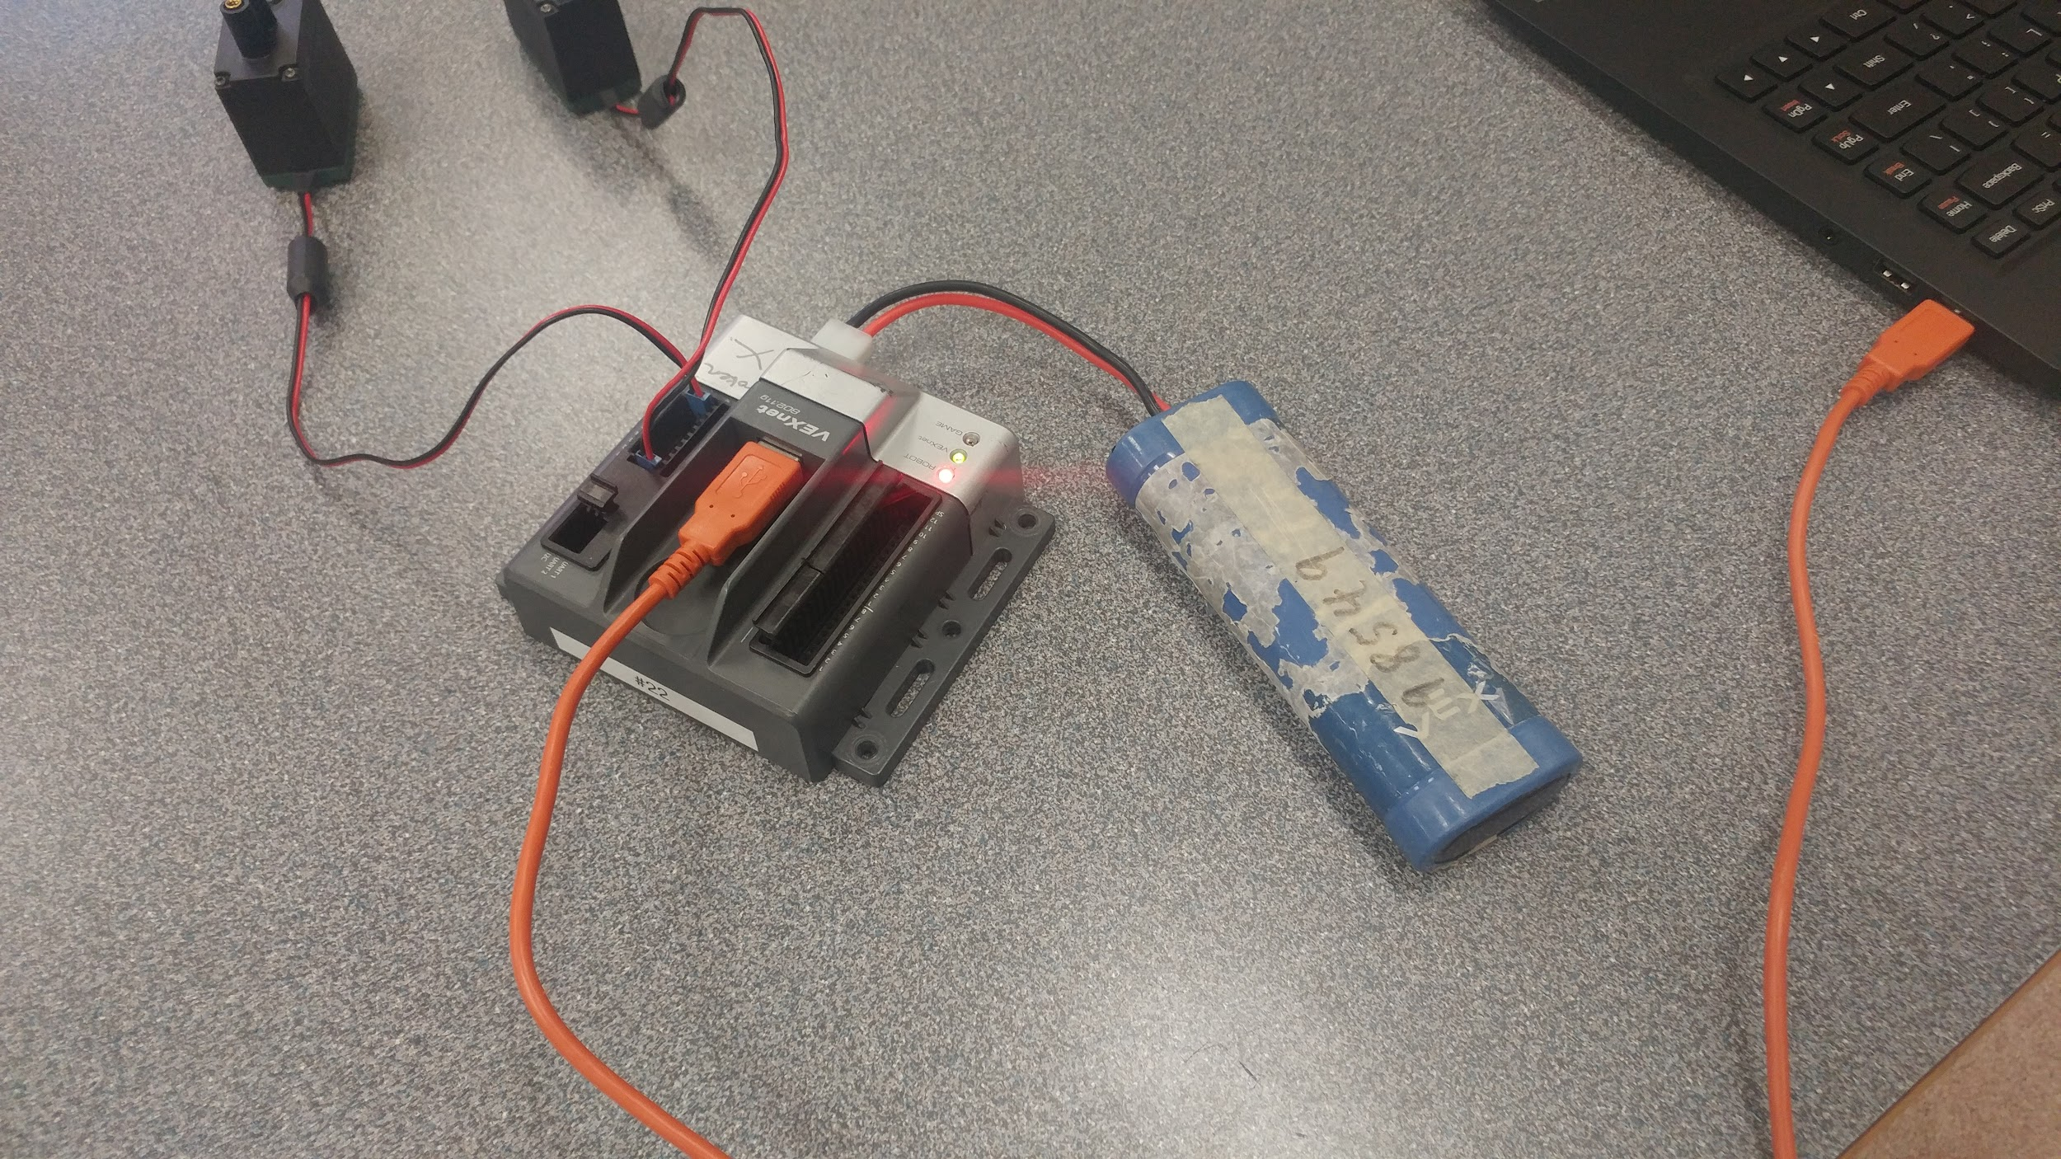
Step 5:
Plug in the battery. Connect the cortex to a laptop with an orange A-to-A cable.
Now the test kit is ready to be programmed!

Slide 8
Programming the Test Kit
-- Setting Up

Slide 9
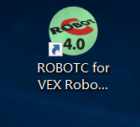
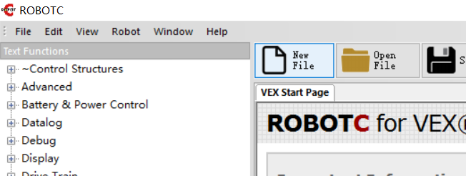
Double click on the ROBOTC icon.
Click on “New File” in the top toolbar (or use the shortcut “ctrl-n”).
On the top-left corner, click on “file -> save as”, and save it at a proper location with a filename including the names of your group members.

Slide 10
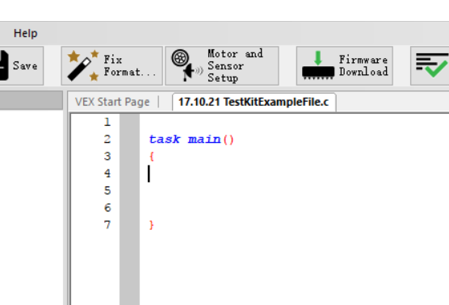
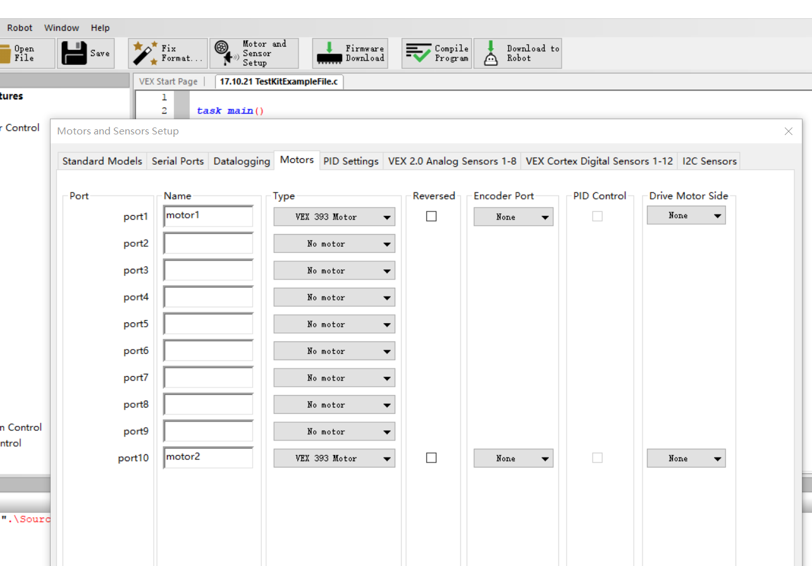
4. Select “Motor and Sensor Setup” on the top toolbar. The window below should pop up.
5. Go under the “motor” tab. Set the type to “VEX 393 Motor” in the ports where your motors are plugged into, and then name the motors. Types and names can be different for every robot.
Hit “enter” to save your motor set up.

Slide 11
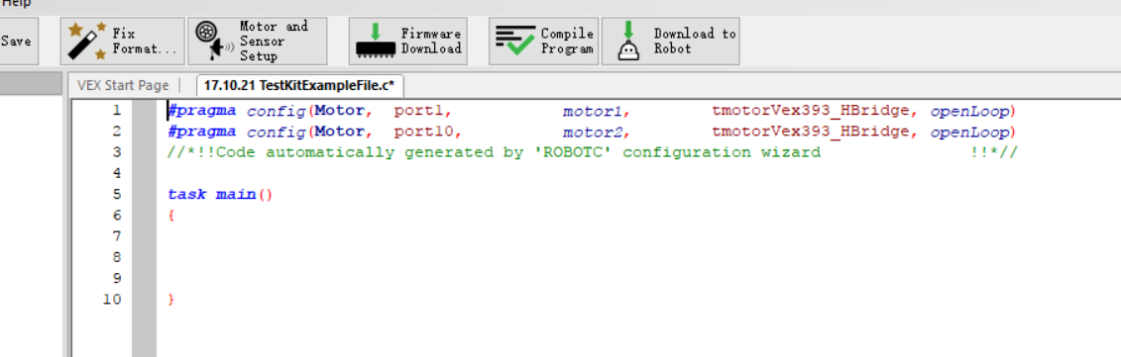
6. There should be similar kind of system generated statements as above. These are called pragma statements. Please do not change anything, not even the symbols or brackets or spacing. Changing the pragma statements may break your entire code.

Slide 12
Programming the Test Kit
-- Basic Movement

Slide 13
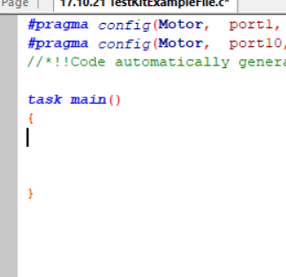
The basic logic of programming in ROBOTC is by telling the robot:
What it is doing
For how much time
A common mistake in the beginning stages is to only tell the robot what to do, but not giving it a timeframe.
Keeping that in mind, we can start by clicking in between the two brackets under “task main ()”.
Task main is, as the name suggests, the main task of the robot, a.k.a. what it is running when it turns on. The two brackets {} shows where this task starts and ends.

Slide 14
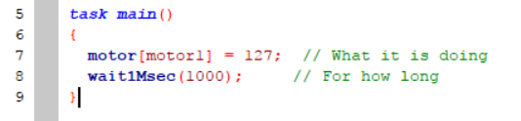
So here are the two basic commands to the robot. Coding is essentially translating human language to the robot’s language. So we want the robot to:
Run motor1 at full power.
Do that for 1 second.
Now we translate that into robot language:

Slide 15
1. motor[motor1] = 127;
[motor1] specifies which motor. Whenever we are picking which motor, or sensor, or button on the joystick to use, we put its name inside square brackets [] to indicate the selection
Equal sign = in code means to assign whatever value is on the right (127) to the items on its left, motor[motor1].
127 is the maximum power of the robot clockwise. -127 is the maximum power counterclockwise. 0 means no power is given, hence stopping.
Semicolon ; is used at the end of every statement you give, like the period to a sentence. However, they don’t show up after brackets {}.
This statement basically says: Set the motor named [motor1] to a power of 127.

Slide 16
2. wait1Msec(1000);
wait1Msec() is a built-in command to tell the robot “for how long”. The unit is millisecond.
(1000) specifies the amount of time. 1000 millisecond is one second.
Note that wait1Msec() doesn’t mean doing nothing, but instead it gives the timeframe in which any previous statements about “what it is doing” will run.
Semicolon ; is used at the end of every statement you give, like the period to a sentence. However, they don’t show up after brackets {}.
This statement basically says: Do the previous action for 1000 milliseconds (or 1 second). Or it can mean: wait 1000 milliseconds (1 second) before continuing to the next statement.

Slide 17
You may have noticed the green words // What it is doing
Double slashes // means to comment in ROBOTC. Any words after // in that line will show up green, and have no actual effect.
It is a good habit to comment on the code so you and your teammates know what is happening.

Slide 18
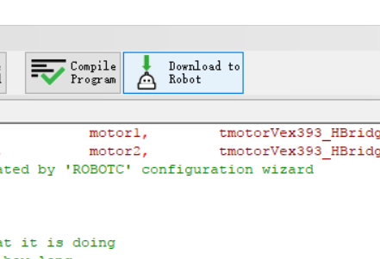
To download this code onto your test kit:
Make sure your cortex is on and connected to your laptop.
Click on “Download to Robot”.
Click “start” in the debugger window.
Ideally, one of your wheels should turn for 1 second.

Slide 19
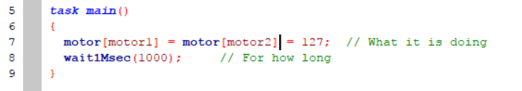
To get the second wheel moving as well, simply add another = motor[motor2] in your “what it is doing statement”.
You may have noticed spaces here and there. ROBOTC doesn’t read whitespace. That means, it doesn’t make a difference how your space things out, indent, or even change lines. That is also why the semicolon; is super important -- it is the only way for the robot to know which line is next. However, even though whitespace doesn’t matter, it helps to keep the code clean and easy to read.

Slide 20
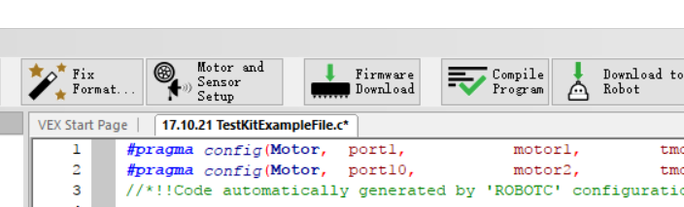
If your test kit doesn’t work at all, the most likely case is that the cortex needs a firmware update. To do that, turn your cortex off, and click on “Firmware Download” in the toolbar.
After the firmware update, turn your cortex on and try to download the code again.

Slide 21
Programming the Test Kit
-- Buttons!

Slide 22
Take pictures with the button
Plug in the button in digital sensor port 1 of the cortex with the black wire facing out. The limit switch will work exactly the same.

Slide 23
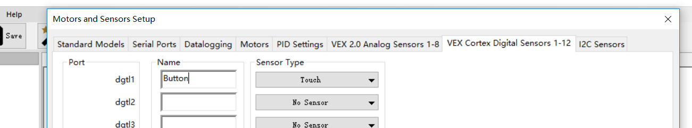
In the same ROBOTC file, go to “motor and sensor setup”, go under the “VEX Cortex Digital Sensors” tab, and change the sensor type in port 1 to Touch. Name it as “Button”. Hit “enter” to save the changes.
It doesn’t matter what you name it to, as long as you refer to it with that name in your code.

Slide 24
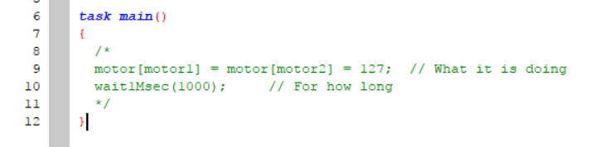
First of all, comment out all the previous code inside task main. You can put // in front of those lines, or place /* before the section, and */ after the section you want to comment out. These two symbols comment out all the code in between them.

Slide 25
Start
What we want to program the test kit to do is:
When the button is pressed, run the motors
When the button is not pressed, stop the motors
Repeat this process
Button pressed?
Yes
Loop
Back
Forever
No
Run the motor
Stop the motor
This can be converted to more robotic logic:
Check whether the button is pressed
Yes! Now run the motor.
No. Now stop the motor.
Repeat this process
Next step

Slide 26
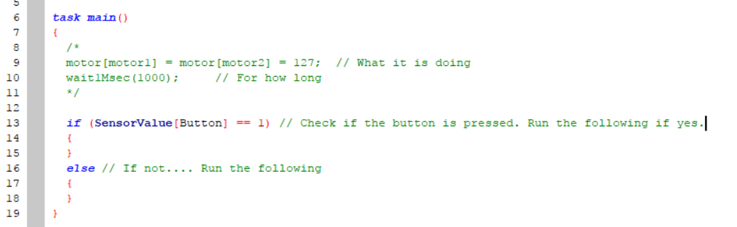
In the code above, we used something called the if loop:
if (conditions)
{
statements if condition is true
}
else
{
statements if condition is false
}
In the parenthesis (), we have the condition. This is what the code is checking.
If the condition is true, the block of code right under it will be run.
If the condition is false, the block of code after else will be run.
Brackets {} show that these lines of code belong to the same block.

Slide 27
In this case, the condition is whether the button is pressed. This is translated into robot language:
SensorValue[Button] == 1 inside the parenthesis.
Just like motor[motor1], SensorValue[Button] is specifying the sensor called button.
Unlike motors, we are not assigning a value to the sensor; here we want to check if the button is pressed.
For all touch sensors or joystick buttons, 1 means pressed, and 0 means not pressed.
Using double equal signs ==, we are comparing whether the right side is equal to the left side.

Slide 28
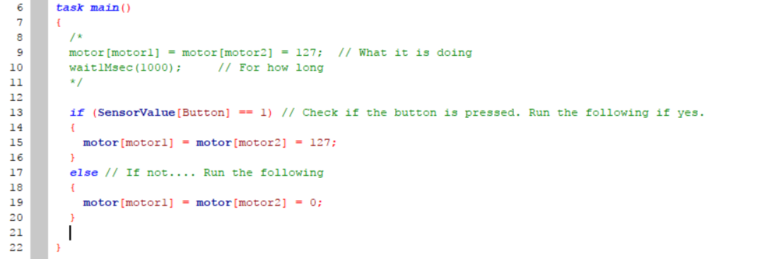
Now let’s add the code telling the motors what to do when the button is pressed or not pressed.
Translating back into human language, this code says:
Check if the sensor called button is pressed:
If yes, run both motors at full power.
If not, stop both motors.
Will this work if we download it to the kit? Why or why not?

Slide 29
Start
Going back to the flowchart, what we want to program the test kit to do is:
When the button is pressed, run the motors
When the button is not pressed, stop the motors
Repeat this process
Our code on the last slide was missing the part to repeat this process. We made a code telling the robot what to do, but not how long.
Button pressed?
Yes
Loop
Back
Forever
No
Run the motor
Stop the motor
Next step

Slide 30
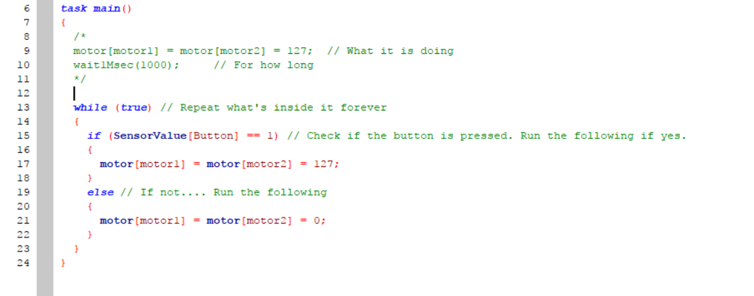
To make the cortex repeat something forever, we use a while (true) loop:
while (condition)
{
}
Like an if loop, the while loop check the condition in the parenthesis, and run its code block if that condition is true.
However, the if loop only checks the code once and moves on to the next block. The while loop keeps on checking its condition, and the block of code keeps on running as long as the condition is true.

Slide 31
In this case, the condition is “true”, which is true forever, and keeps the block running forever.
To represent true, you can also use “ 1==1 ”, or “1” as the condition. Like the buttons, 1 means true, and 0 means false in coding logic.

Slide 32
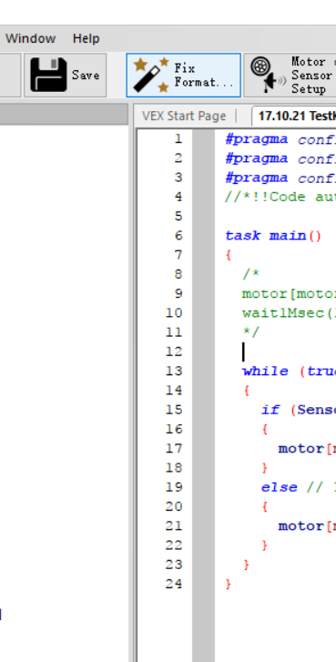
There are a lot of brackets {} once we start using loops. Sometimes, it can be difficult to figure out whether all brackets are closed properly.
A good habit is to always type out a set of brackets (opening and closing ones) first, before typing anything inside the brackets.
An easy way to line things up is by clicking the “Fix Format” button in the toolbar. After doing that, your last few brackets should form a staircase pattern and there shouldn’t be two close brackets } on the same indent level.

Slide 33
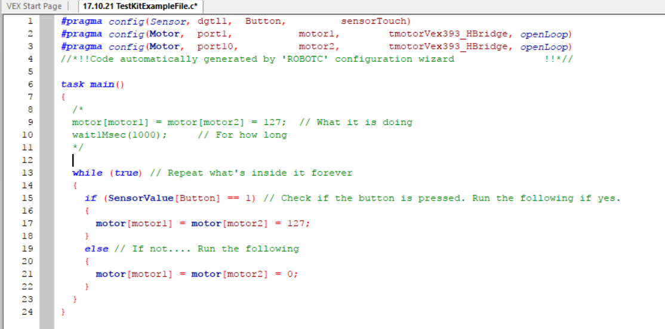
Download this to the cortex and try it out! If it works, congrats, the button is programmed properly!

Slide 34
Programming the Test Kit
-- Quadrature Encoder

Slide 35
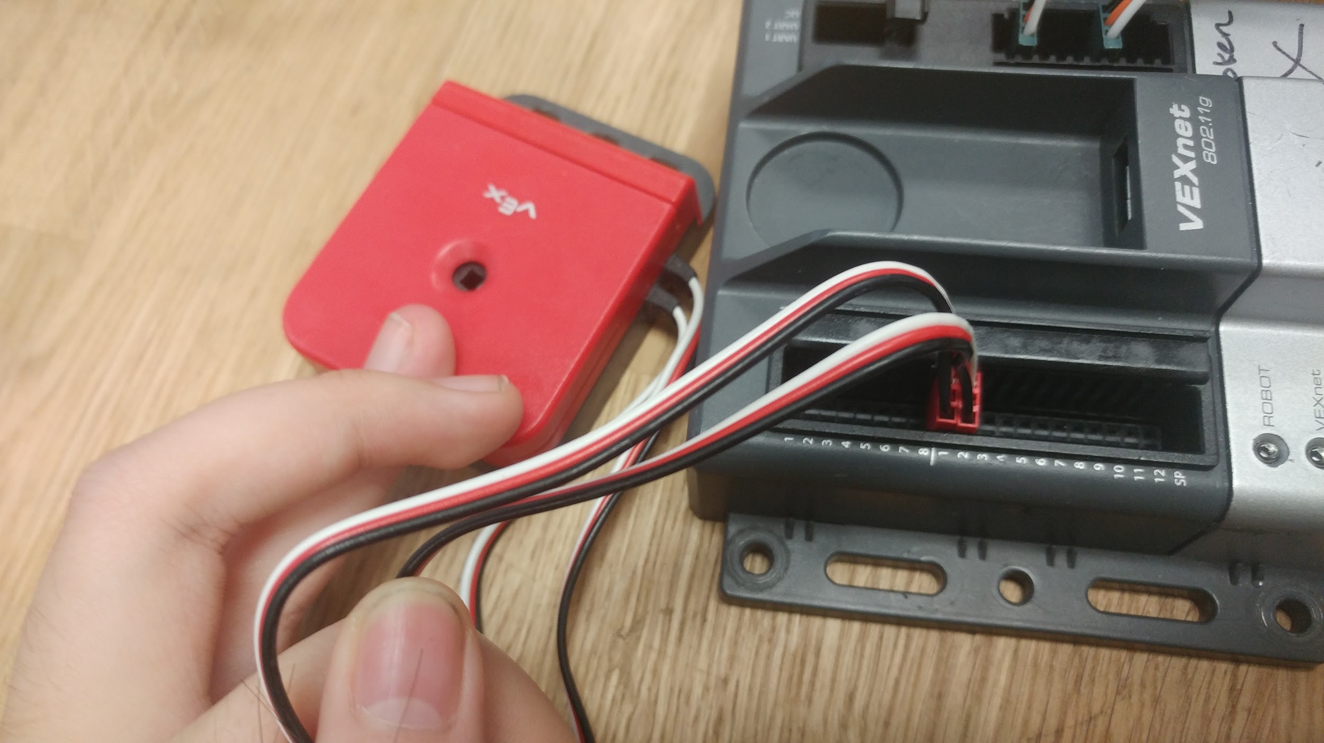
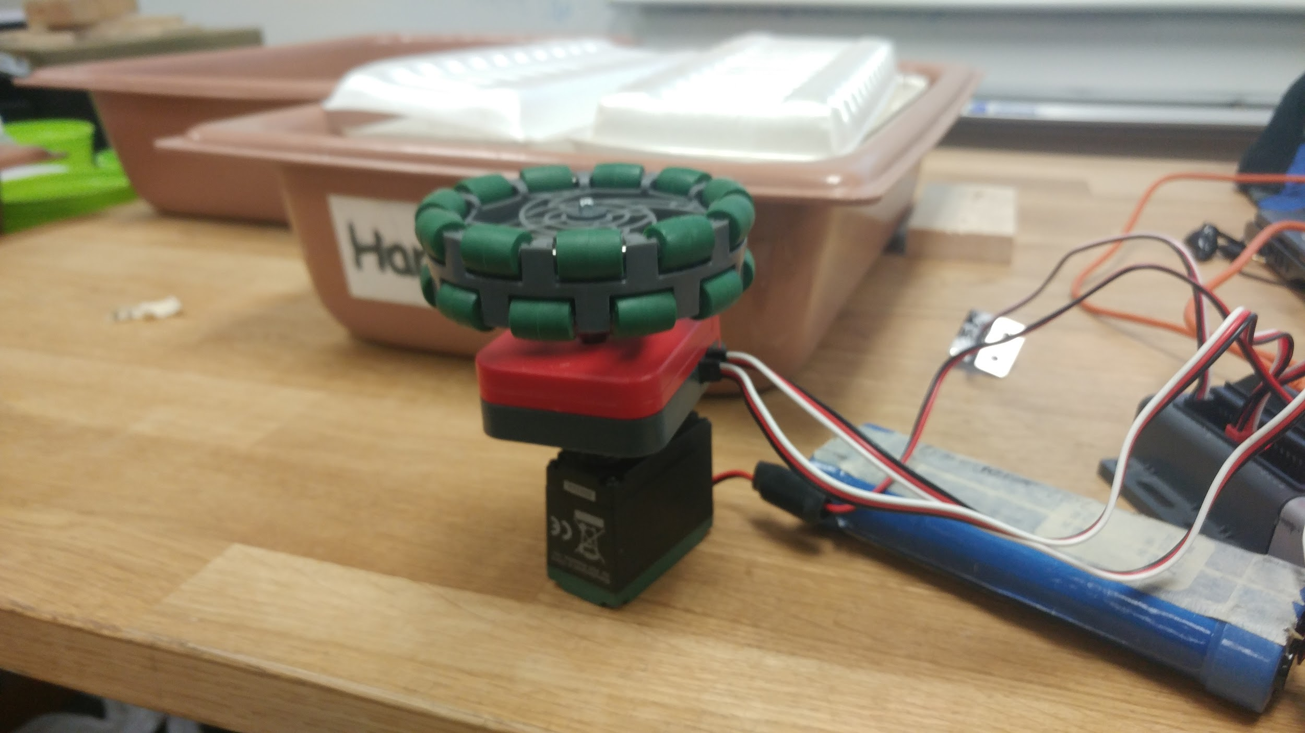
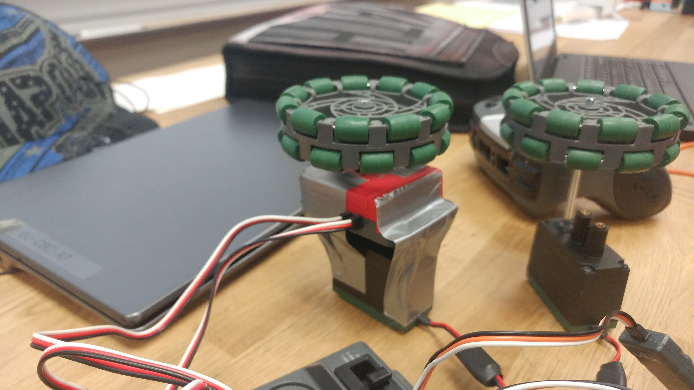
Plug in the quadrature encoder in digital sensor ports. This sensor has two wires and they need to be adjacent to each other.
One of the shafts should go through the encoder. Secure the encoder so that it doesn’t move as the wheel rotates (we used duct tape but it’s not recommended)

Slide 36
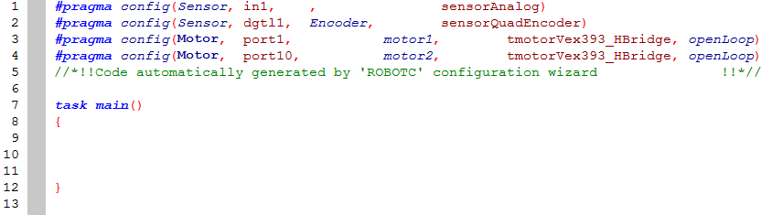
First, configure the Encoder as a digital sensor in its port.
For this example, I started a new file so task main is currently empty.

Slide 37
Start
For my test kit with encoders, I programmed it to run until there are 1000 counts on the encoder and then stop.
I didn’t want this code to repeat itself, and that is shown in the flowchart.
In more robotic language, I want to code the test kit so that:
Check if the encoder value is smaller than 1000.
Yes, then run the motor. Keep checking for a different answer..
No, then stop the motor.
Encoder count<1000?
Yes
No
Run the motor
Stop the motor
Loop back

Slide 38
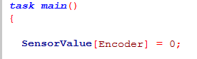
For encoders, and most sensors that can remember values, it is important to reset the sensor value at the beginning of the program.

Slide 39
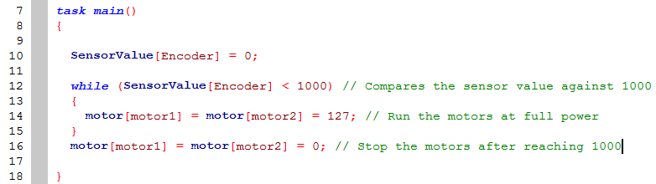
The rest of the code is fairly self-explanatory. Most of the statements and loops already appeared in the button programming tutorial before.
Download this code and see if it works!

Slide 40
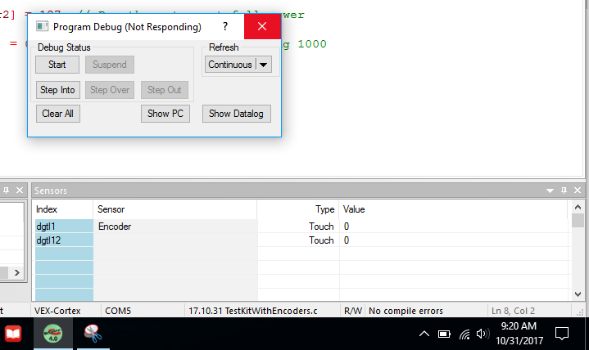
After you download, the following debugger window should appear.
With a programming cable, you can track the counts of the encoder live as the motor is turning.
Be sure to click start whenever you are using the programming cable.

Slide 41
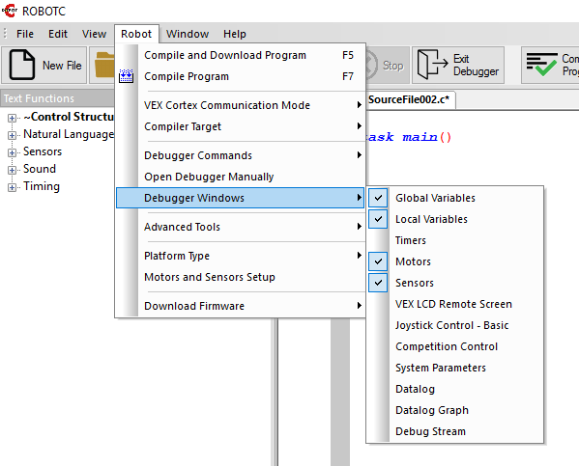
If the sensor tab of the debugger didn’t show up, you can open it through “Robot -> Debugger Windows -> Sensors”.

Slide 42
Comments
I have done the test kit more than 10 times including helping and peer tutoring in other classes. So for this update I had nothing more interesting to do than to make a compilation of my coding knowledge, from the very beginning to doing some loops and sensor applications. Hope anyone who has read this tediously long power point will learn something about coding, and will spread that knowledge to other people.

